Slide 1
VANGAURD MPU (New) / Prodigy MPU
Mindteck Understanding
Design new MPU board for VanGuard Series 5
Based on freescale QorIQ T Series processor supporting
* QUICCEngine for Serial HDLC
* Trace for debugging
* IEEE 1588
* PCIe (External Bridge to convert parallel )
Form factor : 6U cPCI similar to XCalibur 1002 SBC
Backward compatibility with TMPU-1002 transition Card
Design Reuse components from Prodigy APP

Slide 2
VANGAURD MPU
Unused
XCalibur X1002
(Existing)
/ New design with
freescale
QorIQ Processor
  +
TMPU_1002
Breakout
backward compatible
RS232
Ethernet
Port 1
J5
J5
J1, J2 – Compact PCI
100MB Ethernet ports for communication with Train tools workstations
Ethernet
Port 2
J3, J5 – Ethernet, I/O
J3
J3
J3
J3
J2
Ethernet
Port 3
J2
J5
J5
J2
J2
J2
J2
J2
J2
J2
J1
J1
J1
J1
J1
J1
J1
RS485
Port 1
BACKPLANE CONNECTIONS
Isolated RS485 serial ports for communication with Modbus masters or other Controllers
RS485
Port 2
J5
RS485
Port 3
J4
J3
GND
RS485
Port 4
Form factor :
6U Compact PCI

Slide 3
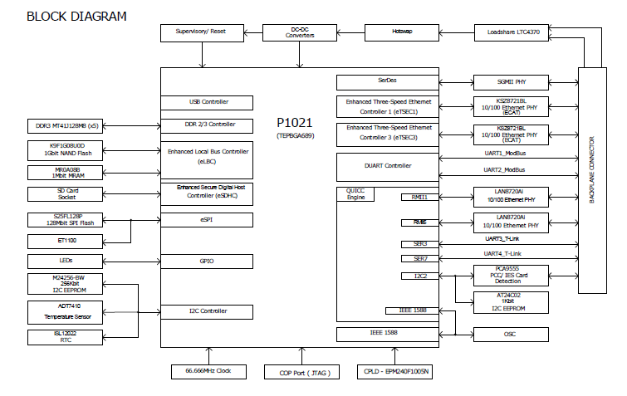
Prodigy APP
(Existing)

Slide 4
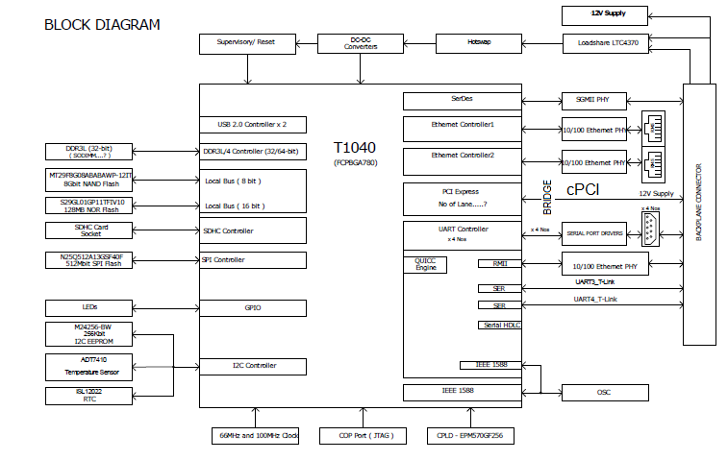
VanGuard MPU / Prodigy MPU
(New)

